Slide 1
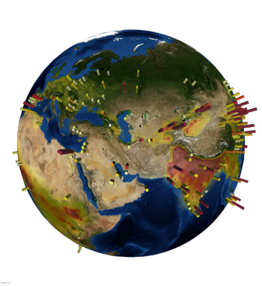
Satellite monitoring of ammonia: from point sources to long-term trends
Van Damme M., Clarisse L., Franco B., Whitburn S., Hadji-Lazaro J., Hurtmans D., Clerbaux C., Coheur P.-F

Slide 2
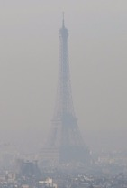
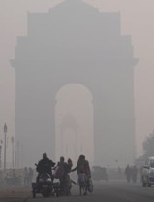
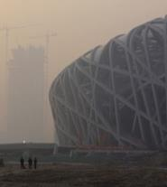
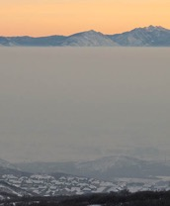
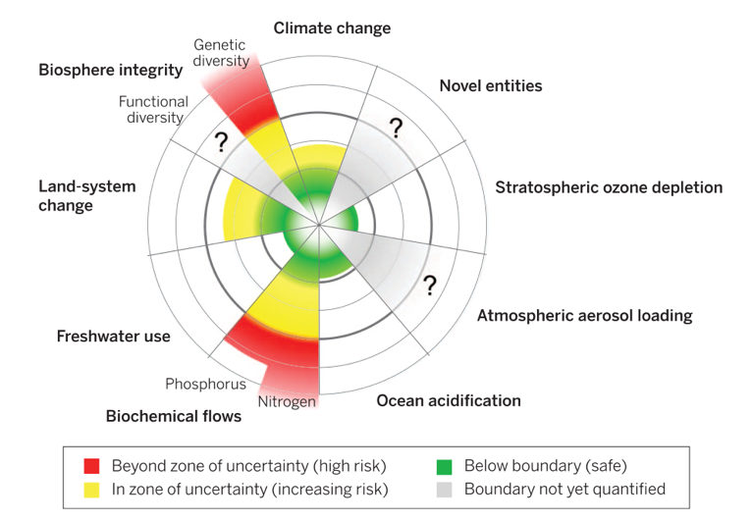
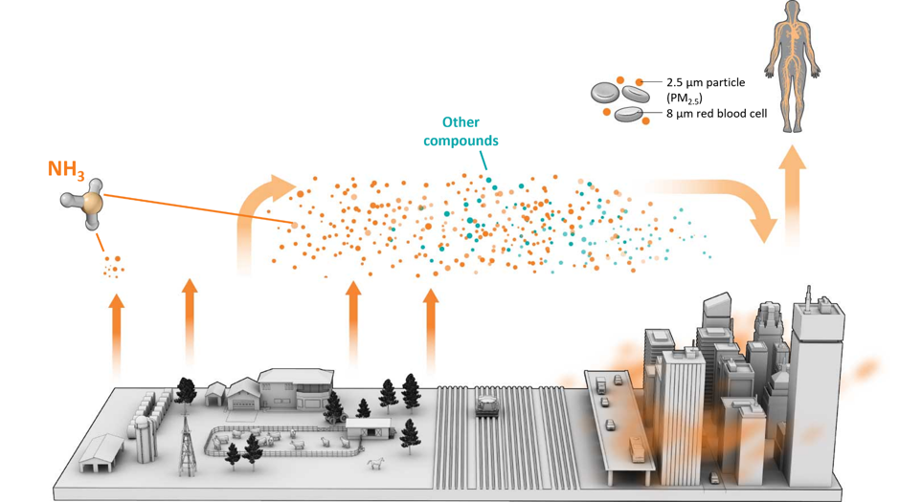
Introduction IASI-NH₃ data record Point Sources Trends
« Planetary boundaries »
=“safe operating space for global societal development with respect to the Earth system and are associated with the planet’s biophysical subsystems or processes”
N cycle is one of the main Earth-system processes for which the control variable has been exceeded
Paris
New Deli
Beijing
Brussels
Salt Lake City
Planetary boundaries
(adapted from Steffen et al., Science, 2015)
(adapted from Desai and Cuadra/Science)

Slide 3
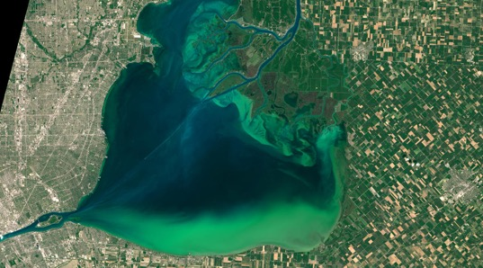
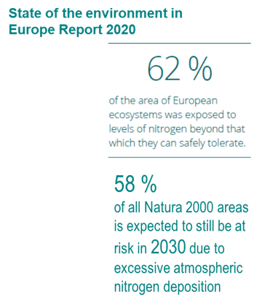
Introduction IASI-NH₃ data record Point Sources Trends
« Planetary boundaries »
=“safe operating space for global societal development with respect to the Earth system and are associated with the planet’s biophysical subsystems or processes”
N cycle is one of the main Earth-system processes for which the control variable has been exceeded
Lake St.Clair, U.S. State of Michigan and Canadian Province of Ontario
Satellite view of cyanobacterial bloom, August 2015 (NASA image)
Bellynahone Bog, Northern Ireland
The CAFRE Ammonia Challenge (Cafre)
Planetary boundaries
(adapted from Steffen et al., Science, 2015)

Slide 4
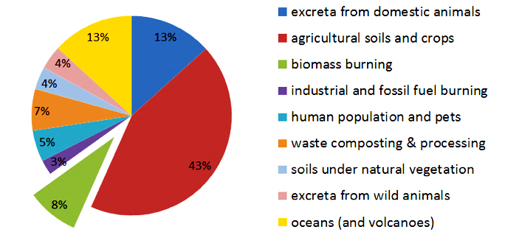
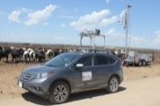
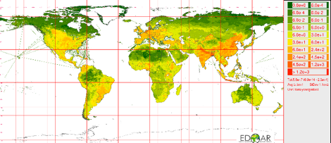
Introduction IASI-NH₃ data record Point Sources Trends
Ammonia (NH₃)
Sources:
Agriculture
Uncertainties from 30% to 100%
Large variations at national/regional scale
Monitoring:
Industry
Measurement networks:
Sparse and integrated (passive sampler)
…but increasing availability!
FTIR: Fourier Transform IR
CIMS: Chemical Ionization Mass Spectrometer
DOAS: Differential Optical Absorption Spectroscopy
(NOAA)
Biomass Burning
(Cabauw)
(Sutton et al., 2013)
Sinks:
Particulate Matter formation
Deposition (wet and dry)
Modelling work:
Highly dependent on the timing and gridding of emissions used as input
Limited by the lack of reliable inventories (and observations)
(M. Zondlo)
Short atmospheric lifetime: from 1 hour to a few days
High spatial and temporal variability
4

Slide 5
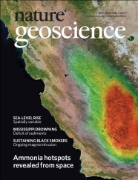
IASI-NH₃
Introduction IASI-NH₃ data record Point Sources Trends
Clarisse et al., Nature Geo
2009
2014
2016
Algorithm and method development
2017
2018
2021
Artiﬁcial Neural Network for IASI = ANNI version 3

Slide 6
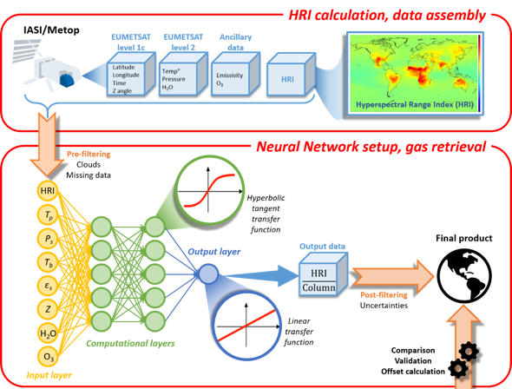
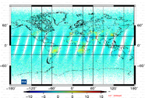
Introduction IASI-NH₃ data record Point Sources Trends
Near-real time processing of IASI radiances at ULB/LATMOS
Processing of IASI Level1C
Level 1C
Hyperspectral Range Index (HRI) calculation
1
Single pixel retrieval
EumetCast distribution
calibrated, apodized, geo-localised radiances
Thermodynamic Level 2 from IASI PPF
or ERA-Interim / ERA5 re-analysis
ECMWF
HRI setup
ANNI
Artificial Neural Network for IASI
Artificial Neural Network – based retrievals
1
Hyperspectral Range Index (HRI) calculation
2
Neural network
2
Neural Network
Total columns
+ errors
Total columns NH₃, VOCs
Aerosol Optical Depth
Dust
errors (no averaging kernels)
Training sets
2 datasets
Near-real time: ANNI-NH₃-v3
Reanalysed: ANNI-NH₃-v3R-ERA5
Whitburn et al., JGR-Atm 2016
Van Damme et al., AMT 2017
Franco et al., JGR-Atm 2018
Van Damme et al., ERL 2021
Poster S04 – 10, FRANCO, B. et al.

Slide 7
Introduction IASI-NH₃ data record Point Sources Trends

Slide 8
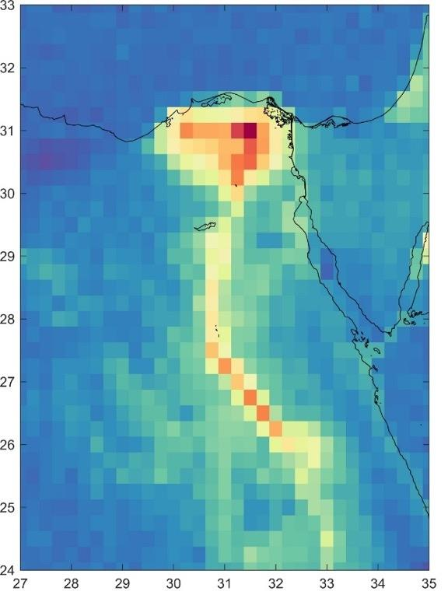
Introduction IASI-NH₃ data record Point Sources Trends
Oversampling
Binned
(0.25°×0.25°)
Classic gridding:
rectangular lat-lon grid
→ cell-size comparable to the spatial resolution of the instrument
only takes into account the location of the centre of the observation and not its spatial extent

Slide 9
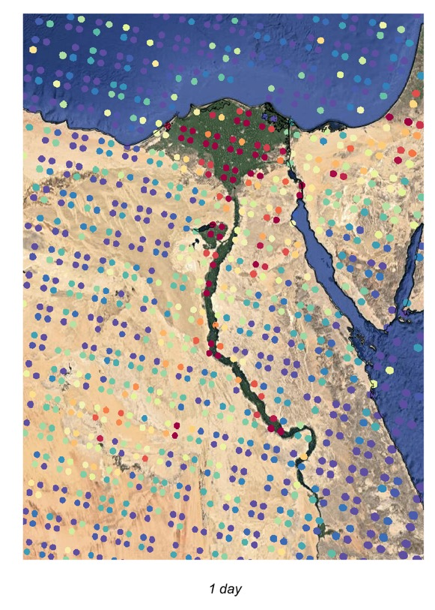
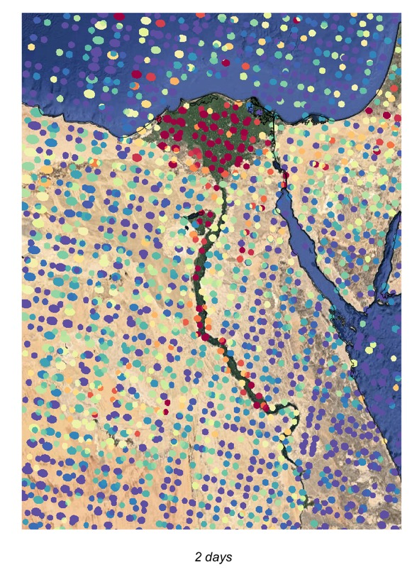
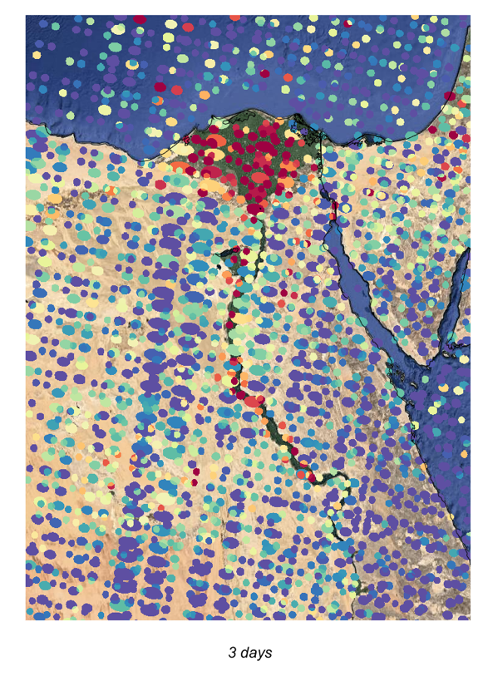
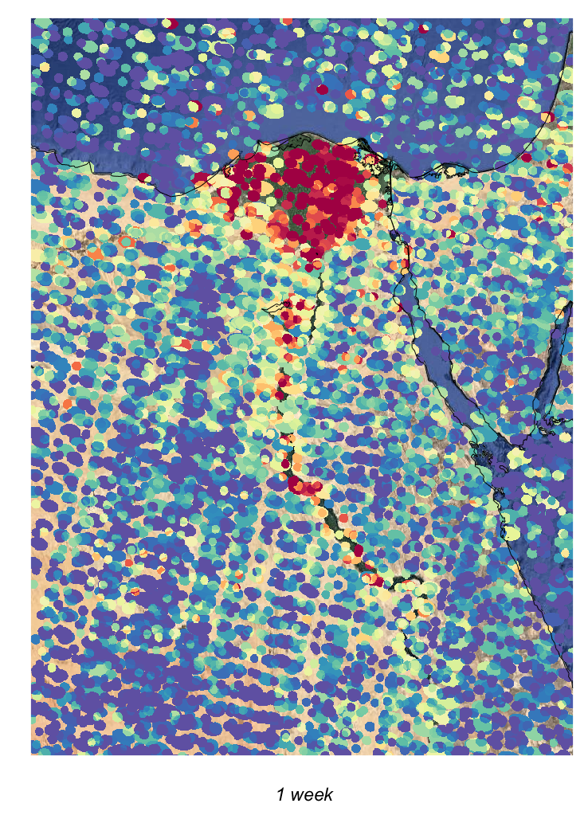
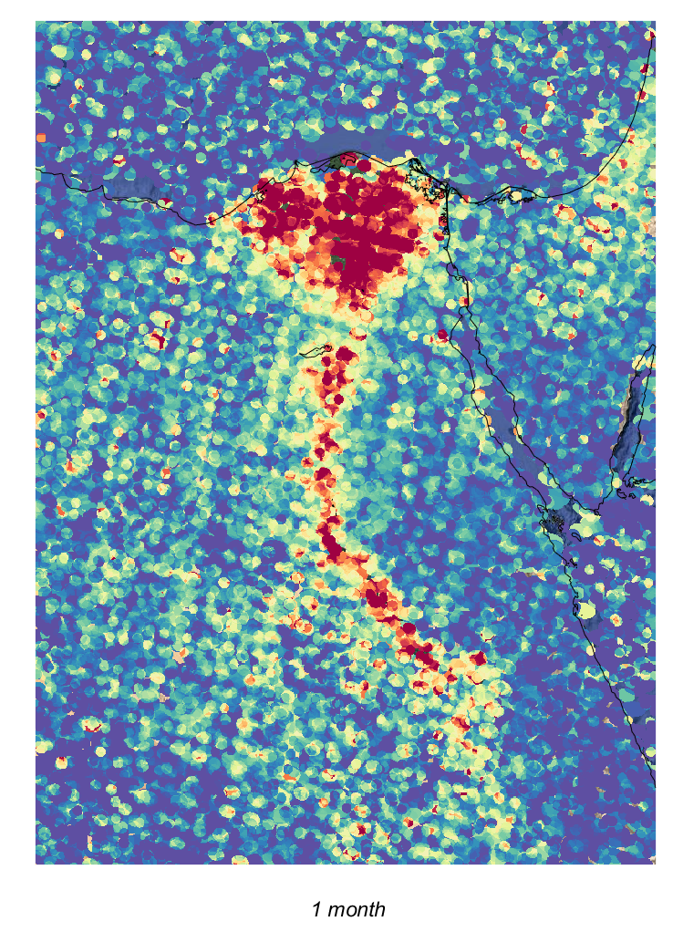
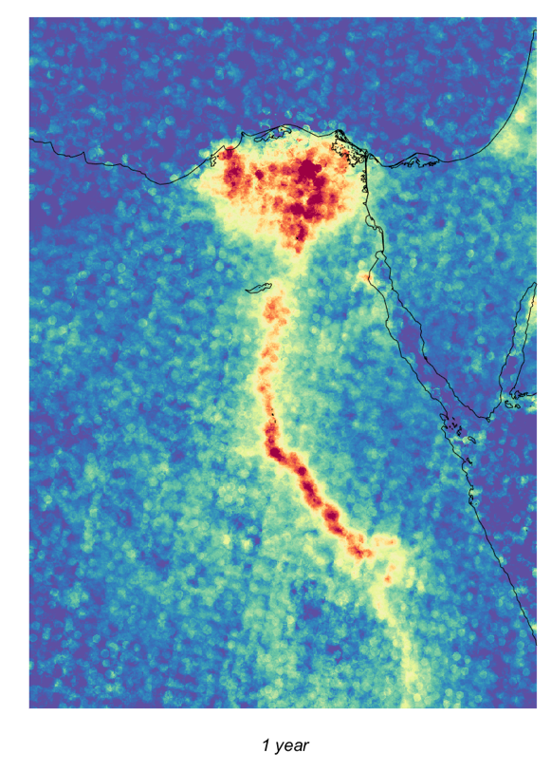
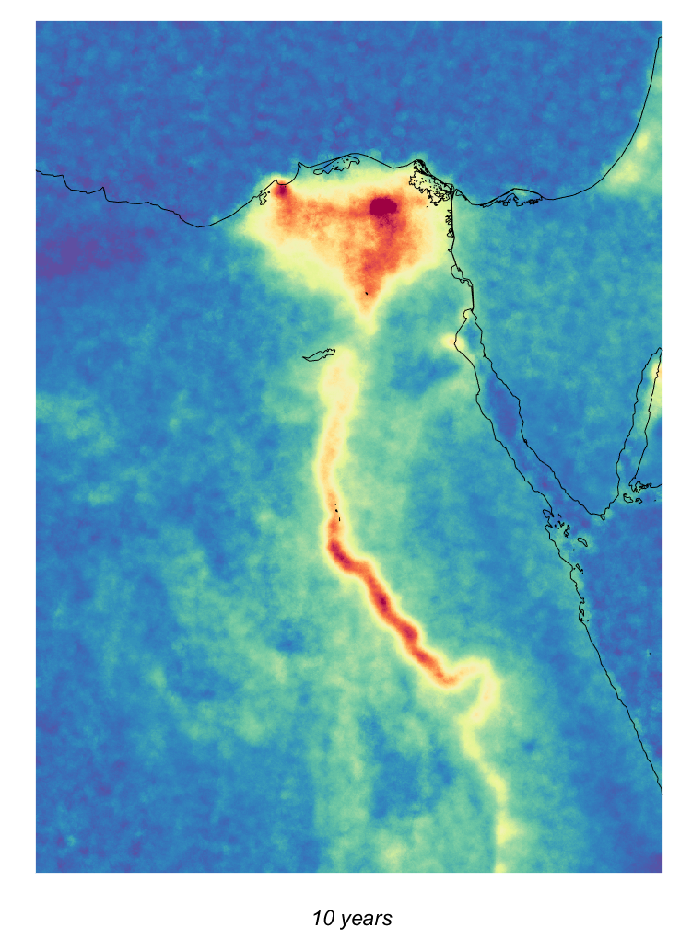
Introduction IASI-NH₃ data record Point Sources Trends
Oversampling
Exploits the fact that the location, shape and orientation of the satellite footprint on the ground varies from one orbit to another
The elliptical footprints of IASI are averaged on a 0.01° × 0.01° high-resolution grid and weighted by the inverse of their footprint area

Slide 10
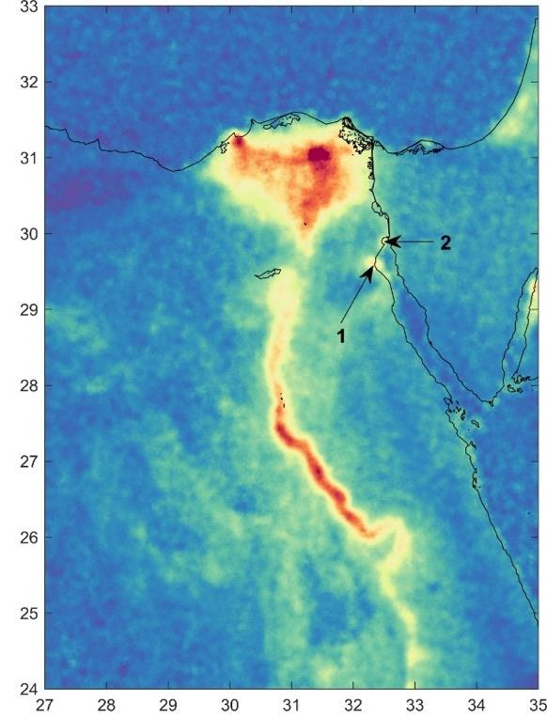
Introduction IASI-NH₃ data record Point Sources Trends
Oversampling
Binned
(0.25°×0.25°)
Oversampled
(0.01°×0.01°)
No artificial post-smoothing!
A considerable increase in resolution is achieved with oversampled averages
1 = Ain Sukhna; 2 = Al-Adabiya

Slide 11
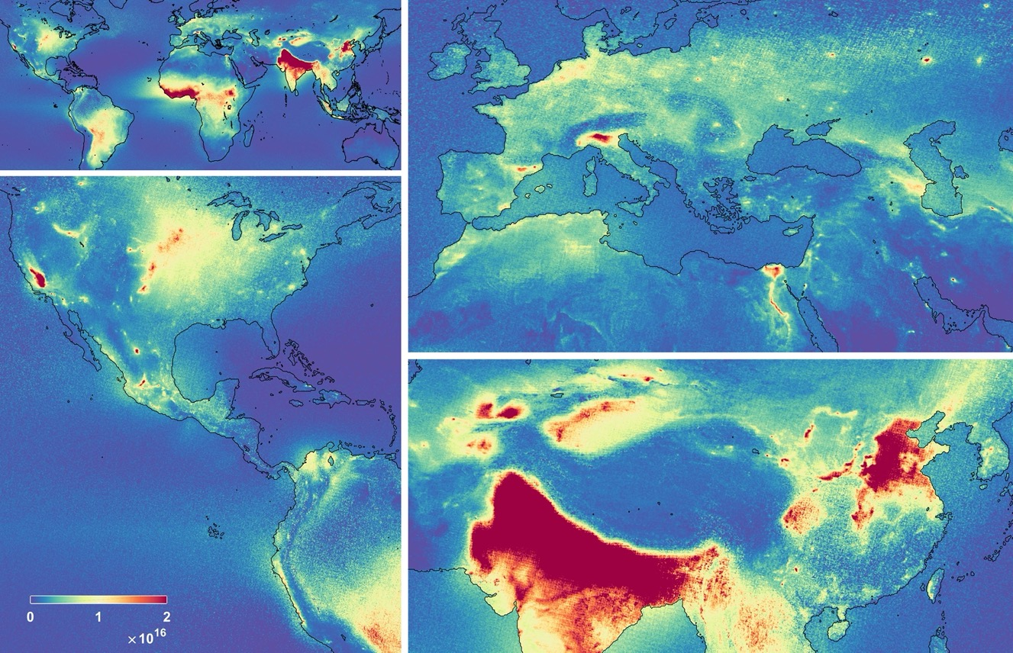
Introduction IASI-NH₃ data record Point Sources Trends
Oversampling
molec/cm²

Slide 12
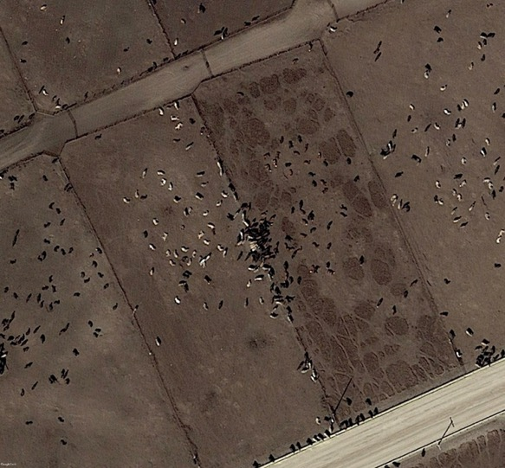
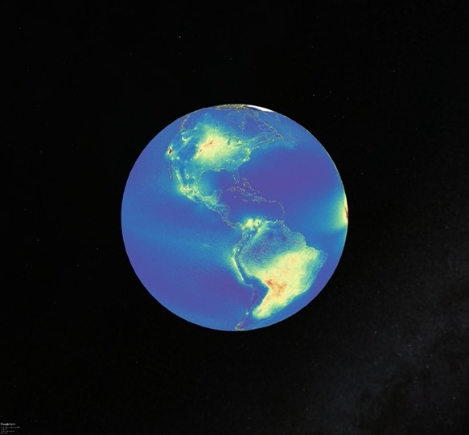
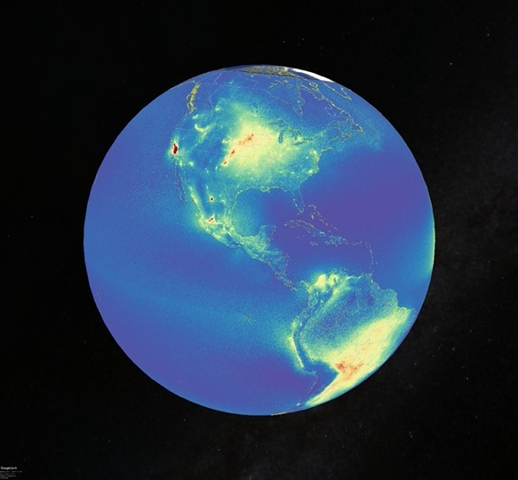
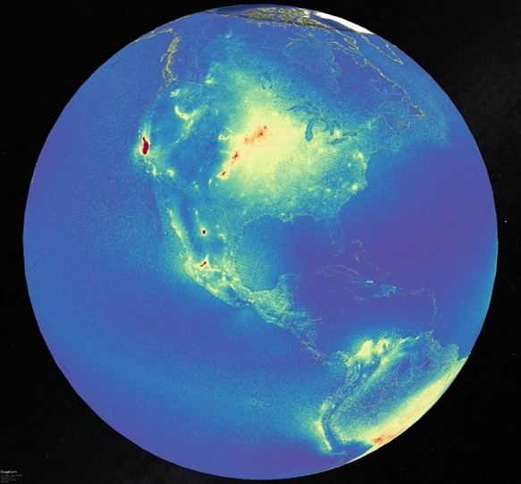
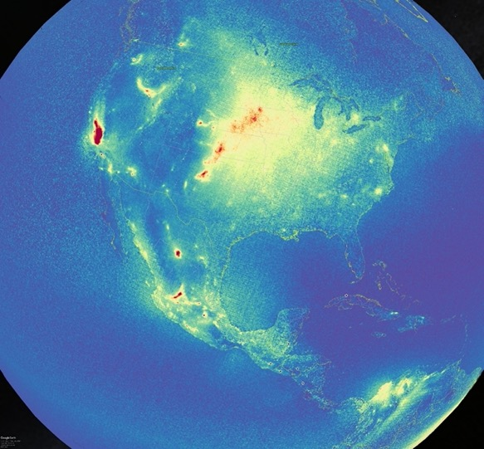
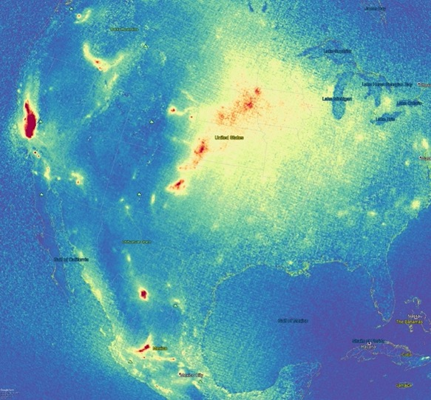
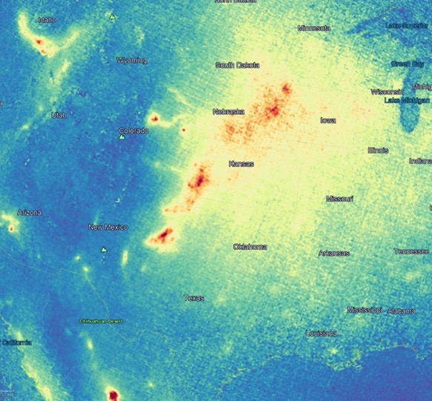
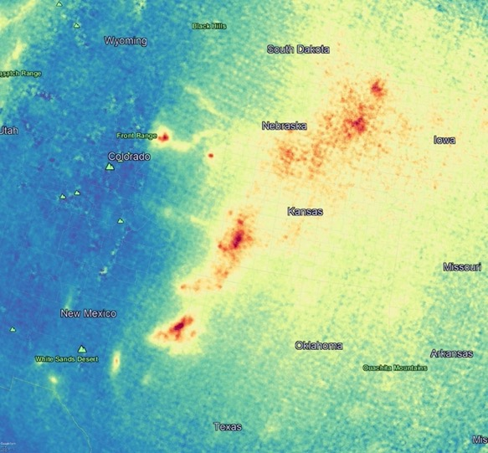
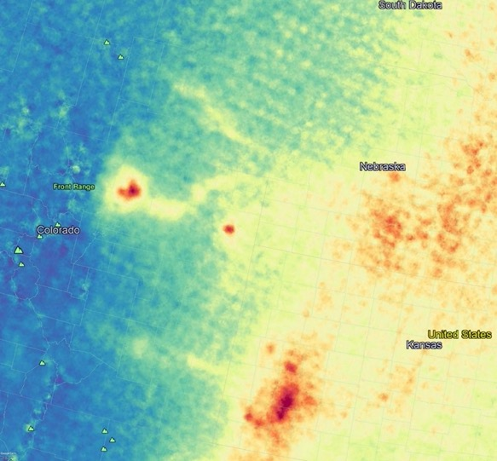
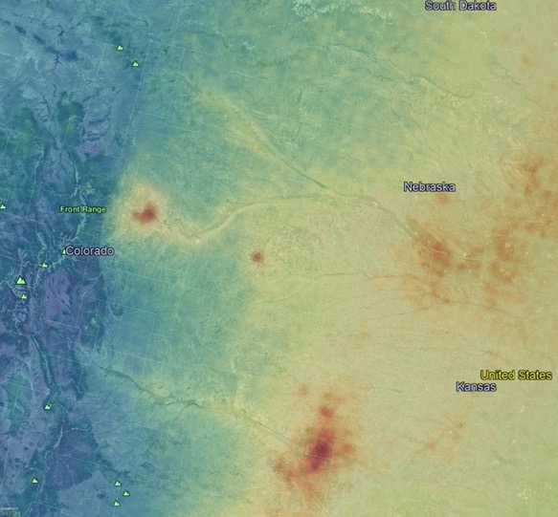
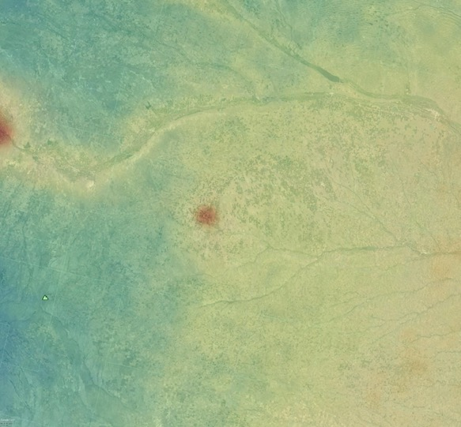
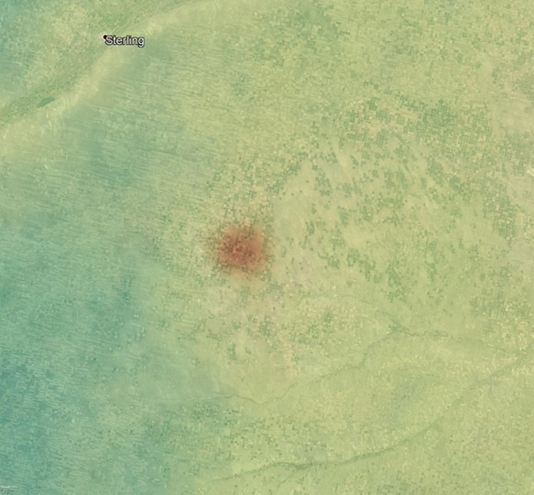
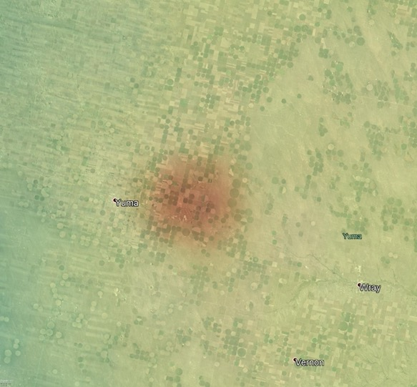
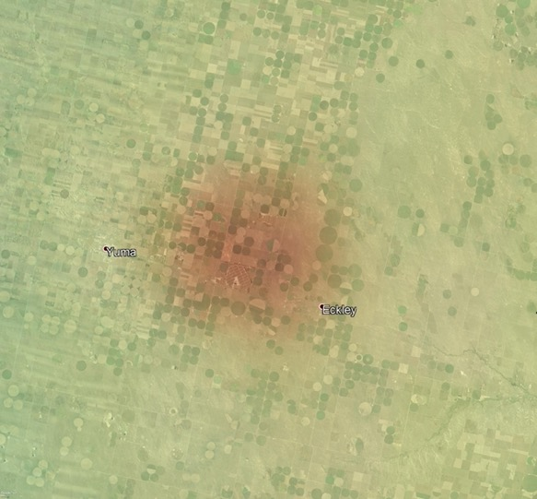
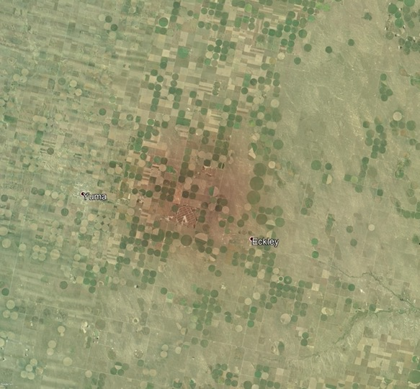
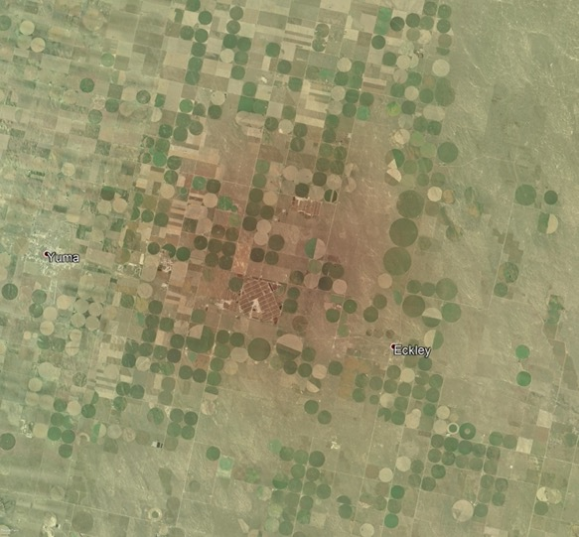
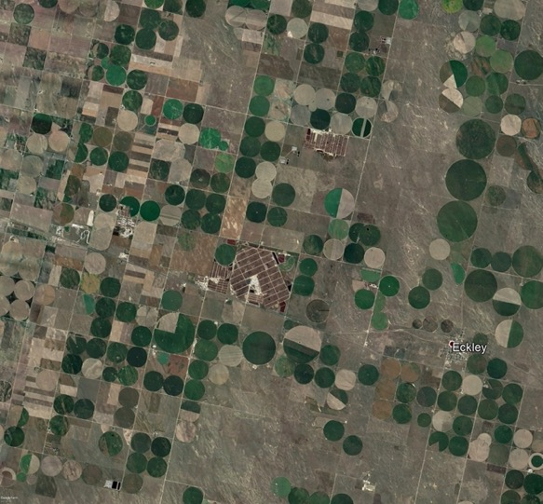
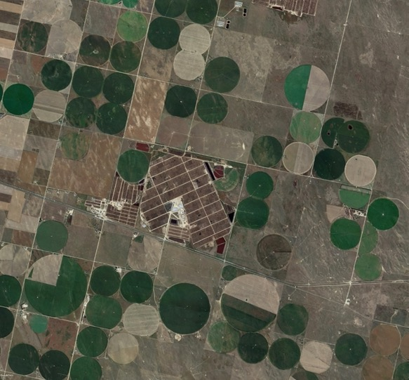
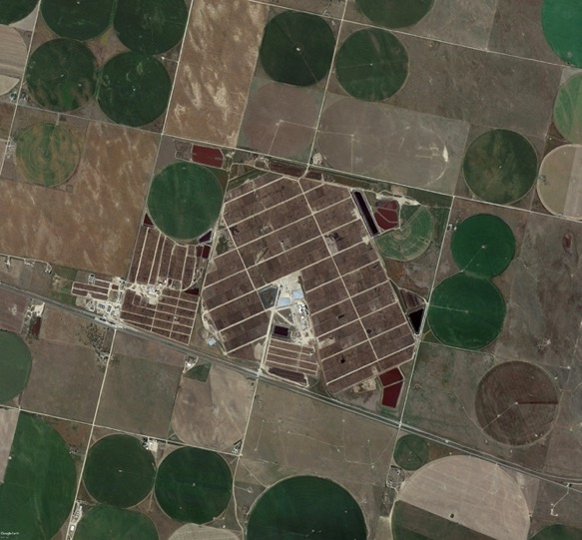
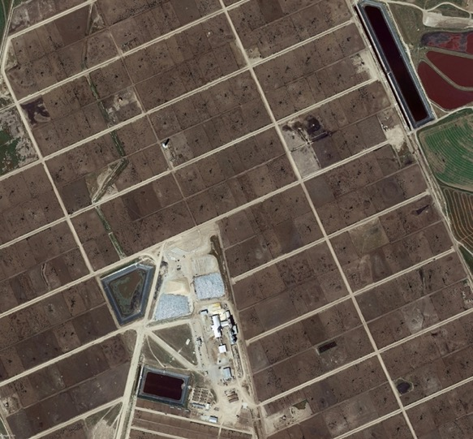
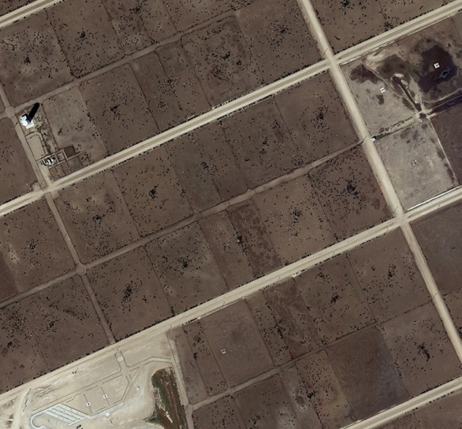
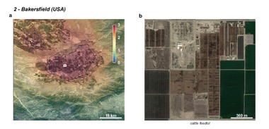
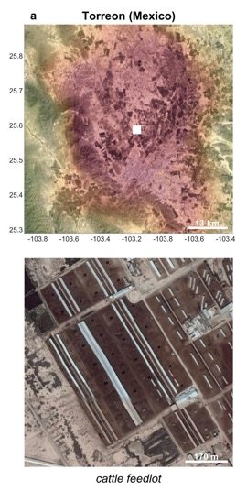
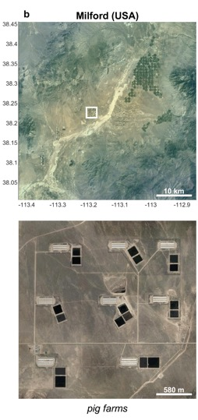
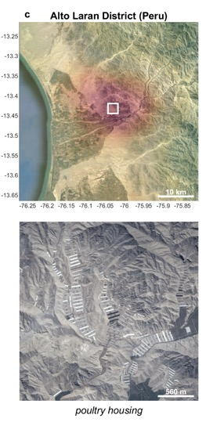
Introduction IASI-NH₃ data record Point Sources Trends
Oversampling
Agricultural
Bakersfield (USA)
Torreon (Mexico)
Milford (USA)
Alto Laran District (Peru)
molec/cm²
Tulare (USA)
Chino (USA)

Slide 13
Introduction IASI-NH₃ data record Point Sources Trends
Oversampling
Industrial
Marvdasht (Iran)
Shizuishan (China)
Moa (Cuba)
Stuparei (Romania)
The Geysers (USA)
molec/cm²
molec/cm²
Poster S10 – 65, NOPPEN L. et al.

Slide 14
Introduction IASI-NH₃ data record Point Sources Trends
Oversampling
>240 hotspots identified (+ >170 source regions) categorized in 3 classes:
Agricultural (83)
Industrial (158)
Natural (1)

Slide 15
Introduction IASI-NH₃ data record Point Sources Trends
Oversampling
Fair agreement for the large majority of source regions
Satellite-derived (kg.s⁻¹)
Very large underestimation of emissions in EDGAR for almost all identified hotspots
2/3 by at least 1 order of magnitude
EDGAR v4.3.1 (kg.s⁻¹)
1 agricultural and 69 industrial hotspots completely absent!
Van Damme et al., Nature 2018

Slide 16
Introduction IASI-NH₃ data record Point Sources Trends
Supersampling
First-time applied to measurements of an atmospheric sounder!
Varying footprint size
(7-13 km²)
Super-resolution
Widely used in
image processing
and
super-resolution microscopy:
e.g. License plate recognition
Video: https://www.youtube.com/watch?v=n-KWjvu6d2Y
Clarisse et al., AMT 2019

Slide 17
Introduction IASI-NH₃ data record Point Sources Trends
Supersampling
Feedlot
>500 point sources in 11 classes
Fertilizer industry – Belle Plaine Ammonia Plant
Saskatchewan (Canada)
Clarisse et al., AMT 2019

Slide 18
Introduction IASI-NH₃ data record Point Sources Trends
Supersampling
Feedlot
>500 point sources in 11 classes
Fertilizer industry – Belle Plaine Ammonia Plant
Saskatchewan (Canada)
Online
NH₃ point source catalogue:
https://www2.ulb.ac.be/cpm/NH3-IASI.html

Slide 19
Introduction IASI-NH₃ data record Point Sources Trends
Bootstrap resampling method
Daily time-series at pixel/national/regional scale
ANNI-NH₃-v3R-ERA5 2008-2018 IASI/Metop-A
→ Worldwide decadal increase of 12.8 ± 1.3 % 10yr⁻¹
Temporal trend
(2008-2018)
IASI-NH₃ Total Columns (11-yr average)
Van Damme et al., ERL 2021

Slide 20
Introduction IASI-NH₃ data record Point Sources Trends
National scale:
China’s Clean Air Action (2013)
South Korea (14.6 ± 3.6 % yr⁻¹) and China (6.25 ± 0.68 % yr⁻¹)
Van Damme et al., ERL 2021

Slide 21
Introduction IASI-NH₃ data record Point Sources Trends
NH₃ trends from IASI (2008-2018)
South Korea (14.6 ± 3.6 % yr⁻¹) and China (6.25 ± 0.68 % yr⁻¹)
Pakistan (1.86 ± 0.78 % yr⁻¹) and India (0.39 ± 0.49 % yr⁻¹)
Overconsumption of synthetic fertilizers
Urea coated with neem oil and soil pH in India
. = not significant at 2σ
Photo Credit: R_V_Moorthy
Van Damme et al., ERL 2021

Slide 22
Introduction IASI-NH₃ data record Point Sources Trends
NH₃ trends from IASI (2008-2018)
Soil pH
South Korea (14.6 ± 3.6 % yr⁻¹) and China (6.25 ± 0.68 % yr⁻¹)
Pakistan (1.86 ± 0.78 % yr⁻¹) and India (0.39 ± 0.49 % yr⁻¹)
Overconsumption of synthetic fertilizers
Urea coated with neem oil and soil pH in India
. = not significant at 2σ
Atlas of the Biosphere
Van Damme et al., ERL 2021

Slide 23
Introduction IASI-NH₃ data record Point Sources Trends
South Korea (14.6 ± 3.6 % yr⁻¹) and China (6.25 ± 0.68 % yr⁻¹)
Pakistan (1.86 ± 0.78 % yr⁻¹) and India (0.39 ± 0.49 % yr⁻¹)
Overconsumption of synthetic fertilizers
Urea coated with neem oil and soil pH in India
European countries between +2 and +4.2 % yr⁻¹
>< Gothenburg Protocol and National Emission Ceilings Directive
Van Damme et al., ERL 2021

Slide 24
Introduction IASI-NH₃ data record Point Sources Trends
The Netherlands:
Reported emissions in 2018 are 63.1 % lower than 1990, but levelled off since 2010
2008-2018 trend:
IASI (satellite):
3.6 ± 1.9 % yr⁻¹
National Air Quality Monitoring Network (ground-based):
2.5 ± 0.5 % yr⁻¹
2018 jump due to exceptional weather conditions
+ ‘Dutch Nitrogen Crisis’
end of 2019
Van Damme et al., ERL 2021

Slide 25
Introduction IASI-NH₃ data record Point Sources Trends
Extending the time-series:

Slide 26
Satellite monitoring of ammonia: from point sources to long-term trends
Thank you for your attention!
References :
Whitburn et al., JGR-Atm 2016 https://doi.org/10.1002/2016JD024828
Van Damme et al., AMT 2017 https://doi.org/10.5194/amt-10-4905-2017
Van Damme et al., Nature 2018 https://doi.org/10.1038/s41586-018-0747-1
Franco et al., JGR-Atm 2018 https://doi.org/10.1029/2018JD029633
Clarisse et al., Sci. Rep. 2019 https://doi.org/10.1038/s41598-019-39935-3
Clarisse et al., AMT 2019 https://doi.org/10.5194/amt-12-5457-2019
Guo et al., JGR-Atm. 2021 https://doi.org/10.1029/2020JD033475
Van Damme et al., ERL 2021 https://doi.org/10.1088/1748-9326/abd5e0
Related Poster :
Franco, B. et al.: Decadal datasets of major oxygenated volatile organic compounds retrieved from IASI satellite measurements
Noppen, L. et al.: Aircraft observations of NO₂ and NH₃ over selected locations in Germany
Van Damme, M. et al.: Validation of IASI-NH₃ measurements
IASI-NH₃ datasets : http://iasi.aeris-data.fr/NH3
Global NH₃ point source catalogue : https://www2.ulb.ac.be/cpm/NH3-IASI.html
IASI-A, -B, -C NH₃ 2020
Van Damme M., Clarisse L., Franco B., Whitburn S., Hadji-Lazaro J., Hurtmans D., Clerbaux C., Coheur P.-F

Slide 27
Introduction IASI-NH₃ data record Point Sources Trends
Oversampling
Natural
NH₃
Lake Natron
→ Typical Natron conditions:
pH = 10
T° = 35°C
92% of ammoniacal N in solution is present as NH₃
Massive NH₃ emissions occur over Natron’s main mudflat
NH₃ volatilization linked to the drying processes of the lake may be related to the decay of algae (but series of natural processes at play)
Picture: http://animalia-life.club/other/lesser-flamingo-lake-natron.html
NH₃
(molec/cm²)
Lake area
(normalized)
Clarisse et al., Sci. Rep. 2019

Slide 28
Introduction IASI-NH₃ data record Point Sources Trends
Extending the time-series:

Slide 29
Satellite monitoring of ammonia: from point sources to long-term trends
Thank you for your attention!
References :
Whitburn et al., JGR-Atm 2016 https://doi.org/10.1002/2016JD024828
Van Damme et al., AMT 2017 https://doi.org/10.5194/amt-10-4905-2017
Van Damme et al., Nature 2018 https://doi.org/10.1038/s41586-018-0747-1
Franco et al., JGR-Atm 2018 https://doi.org/10.1029/2018JD029633
Clarisse et al., Sci. Rep. 2019 https://doi.org/10.1038/s41598-019-39935-3
Clarisse et al., AMT 2019 https://doi.org/10.5194/amt-12-5457-2019
Guo et al., JGR-Atm. 2021 https://doi.org/10.1029/2020JD033475
Van Damme et al., ERL 2021 https://doi.org/10.1088/1748-9326/abd5e0
Related Poster :
Franco, B. et al.: Decadal datasets of major oxygenated volatile organic compounds retrieved from IASI satellite measurements
Noppen, L. et al.: Aircraft observations of NO₂ and NH₃ over selected locations in Germany
Van Damme, M. et al.: Validation of IASI-NH₃ measurements
IASI-NH₃ datasets : http://iasi.aeris-data.fr/NH3
Global NH₃ point source catalogue : https://www2.ulb.ac.be/cpm/NH3-IASI.html
IASI-A, -B, -C NH₃ 2020
Van Damme M., Clarisse L., Franco B., Whitburn S., Hadji-Lazaro J., Hurtmans D., Clerbaux C., Coheur P.-F

Slide 30
IASI-NH₃ Total Columns (11-yr average)
Introduction IASI-NH₃ data record Point Sources Trends
National scale:
China’s Clean Air Action (2013)
South Korea (14.6 ± 3.6 % yr⁻¹) and China (6.25 ± 0.68 % yr⁻¹)
Van Damme et al., ERL 2021

Slide 31
Introduction IASI-NH₃ data record Point Sources Trends
Marvdasht (Iran)
Nicaro (Cuba)
Bacau (Romania)
Alto Laran District (Peru)
Anju (North Korea)
Wucaiwan (China)
Onset or discontinuation of anthropogenic activities unambiguously detected and monitored
2008
2009
2010
2011
2012
2013
2014
2015
2016
Van Damme et al., Nature 2018

